Slide 1
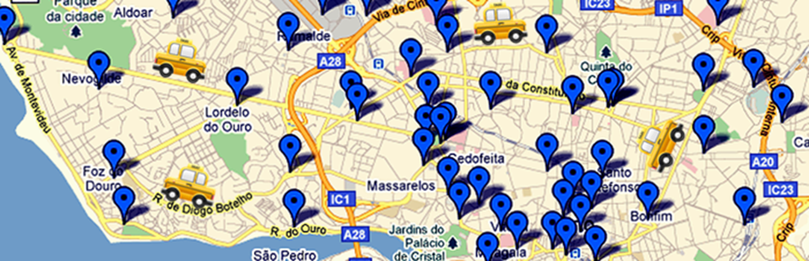
Predicting the Destinations of Taxis on Route
Peter Raynham CKME136 Capstone

Slide 2

Research Problem
Can we predict the destinations of taxis that are on route with customers?

Slide 3
Research Data
City of Porto, Portugal
City population 190,000
Urban area population 1.8 million
Taxis in Porto
442 taxi cabs
1.7 million taxi trips per year
Data Set – Kaggle.com
Data collected for 2013 July to 2014 June
Taxi GPS locations logged every 15 seconds

Slide 4
Data Sample
TRIP_ID: 1372636858620000589
CALL_TYPE: C (street hail)
ORIGIN_CALL:
ORIGIN_STAND:
TAXI_ID: 20000589
TIMESTAMP: 1372636858 (Jul-01 00:00:58)
DAY_TYPE: A (normal day)
POLYLINE: TIME LONGITUDE LATITUDE DIST DIR
0.00: -8.618643, 41.141412, 0m, -
0.25: -8.618499, 41.141376, 22m, -11° W<
0.50: -8.620326, 41.142510, 298m, 155° NE======>
0.75: -8.622153, 41.143815, 306m, 152° NE======>
1.00: -8.623953, 41.144373, 273m, 167° E=====>
1.25: -8.626680, 41.144778, 405m, 174° E========>
. . . . .
4.50: -8.631144, 41.154489, 238m, 43° NW<=====
4.75: -8.630829, 41.154507, 47m, 2° W<=
5.00: -8.630829, 41.154516, 1m, 90° N>
5.25: -8.630829, 41.154498, 2m, -90° S<
5.50: -8.630838, 41.154489, 2m, -143° SE>
ROUTE_LEN: 3.951 km
TRIP_LEN: 2.313 km
AVG_SPEED: 43.1 km/h

Slide 5
Data Cleaning
Problem: Wonky GPS location reports
Affects 12% of trips
Locations momentarily off by up to 10 km
Can taxis really go faster than sound?

Slide 6
Data Preparation
Flatten the dataset to make it fit the model
Trip ID Trip Info List of waypoints
110
trip #1
WP.0
WP.1
WP.2
WP.3
122
trip #2
WP.0
WP.1
WP.2
Trip ID Time Trip info Waypoint snapshot
110
0:15
trip #1
WP.0
WP.1
Flatten from per-trip to per-trip-snapshot observations
110
0:30
trip #1
WP.1
WP.2
110
0:45
trip #1
WP.2
WP.3
122
0:15
trip #2
WP.0
WP.1
122
0:30
trip #2
WP.1
WP.2

Slide 7
Model Design
What model to use?
K Nearest Neighbours (kNN)
Use historical trip data to predict the future
Markov decision process
Apply logic to current location and direction to predict future
→ We choose kNN

Slide 8
Model Implementation
kNN Model Feature Selection:
Recent location data matters most
Features | Mean Error of Predictions
Locations at start and past 5 minutes, weighted to current | 1.89 km
Same, but with even weighting | 1.93 km
Same, including start time-of-day | 2.12 km
Same, including taxi id | 2.36 km

Slide 9
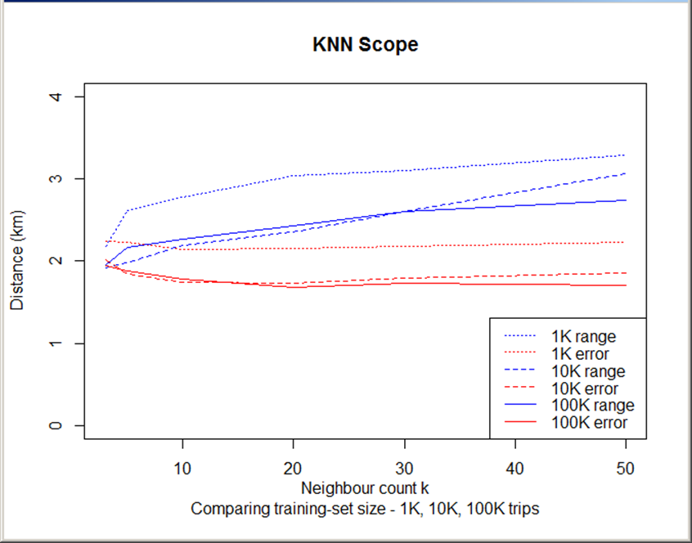
Model Performance
Best results:
k = 30
100,000 training points

Slide 10
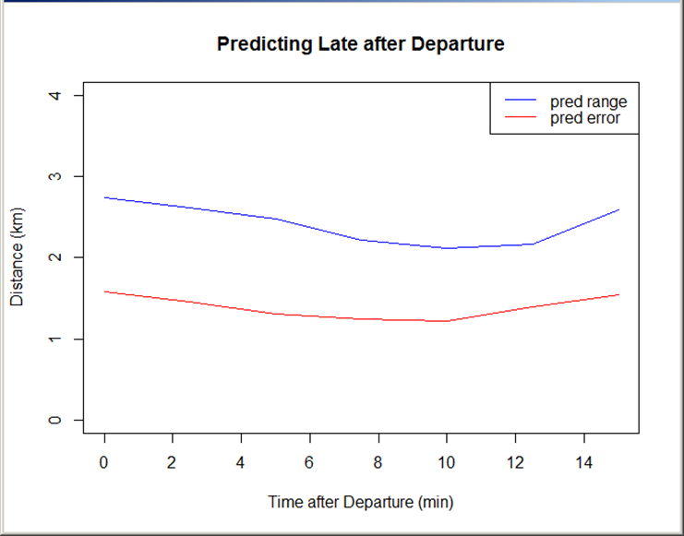
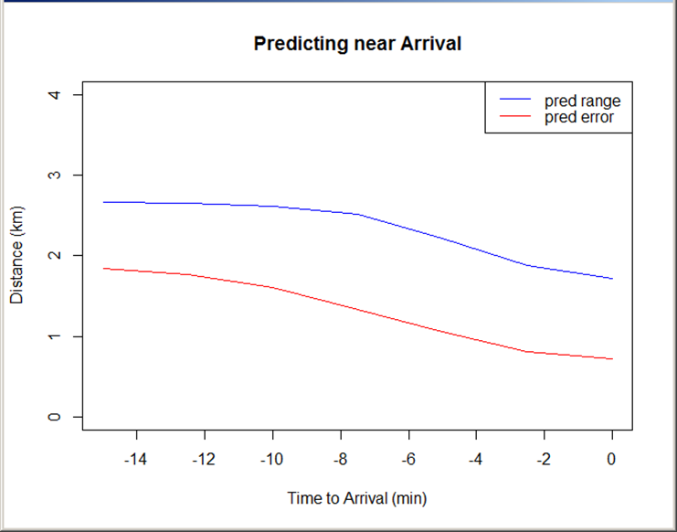
Model Performance
Accuracy improves toward end of trip, … but we don’t know when trip will end.

Slide 11
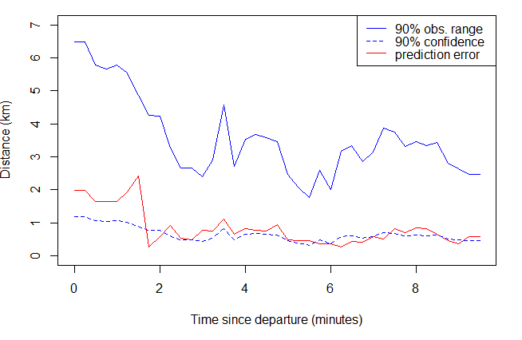
Model Performance
Quality of prediction during one typical trip

Slide 12
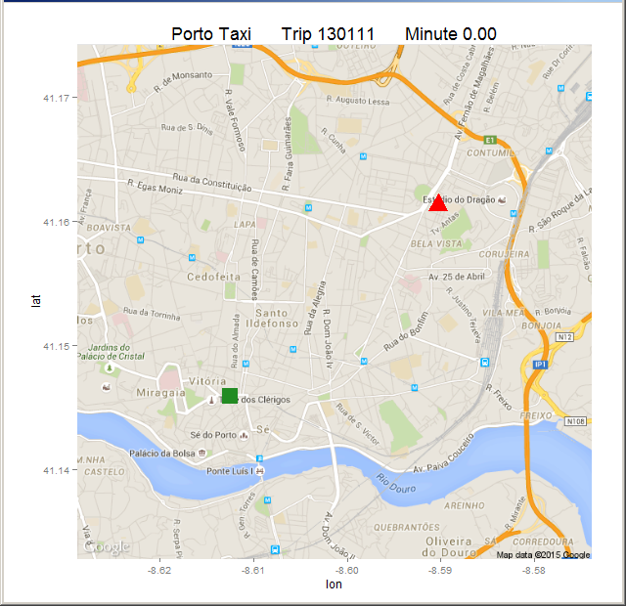
Predicting a Typical Trip
Typical trip
Start
Finish
Route 3.1 km
Time 9.5 min

Slide 13
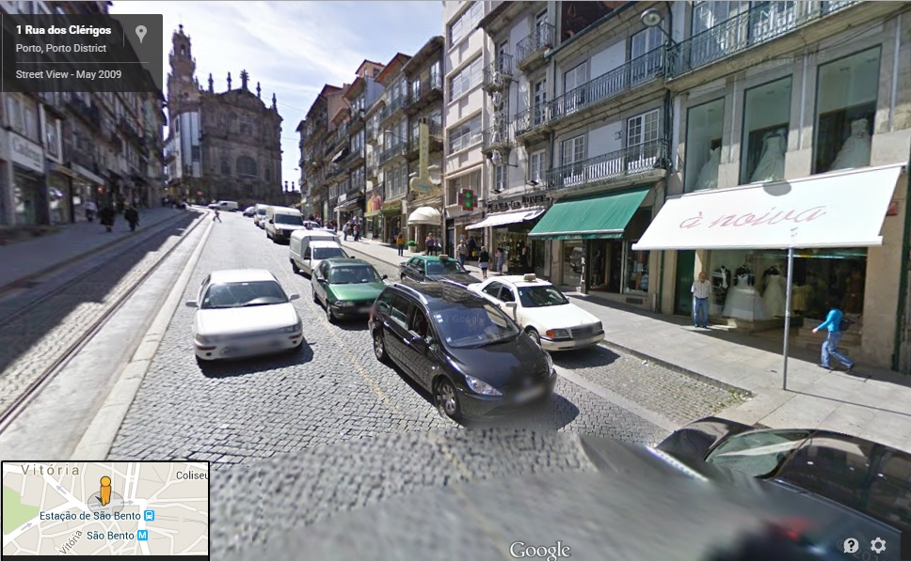
Let’s get rolling …

Slide 14
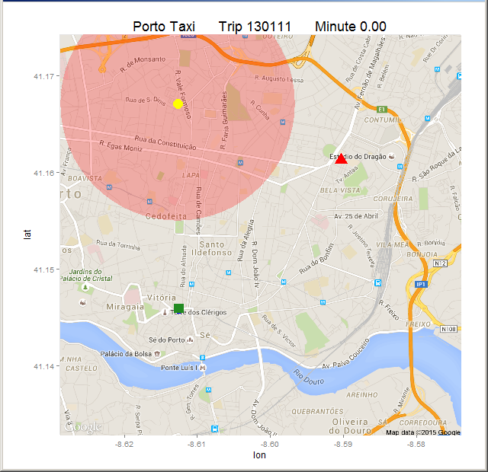
At the start:
With no trip data yet, prediction is far off.

Slide 15
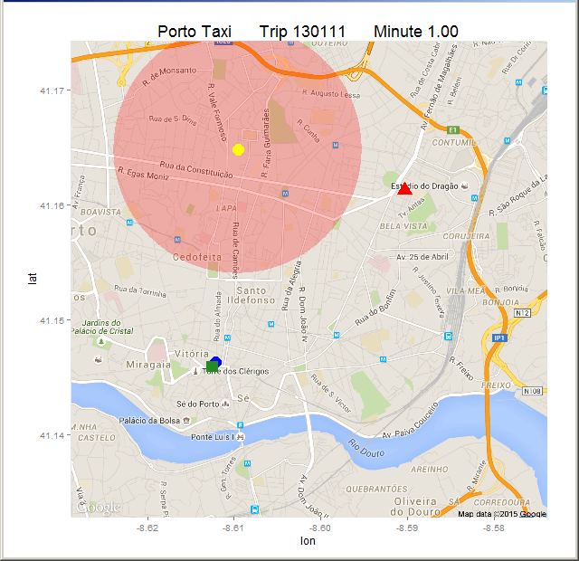
At 1 minute.

Slide 16
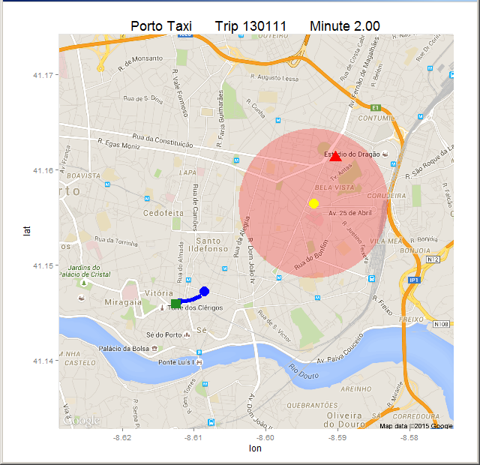
At 2 minutes:
Enough trip data to make an informed prediction.

Slide 17
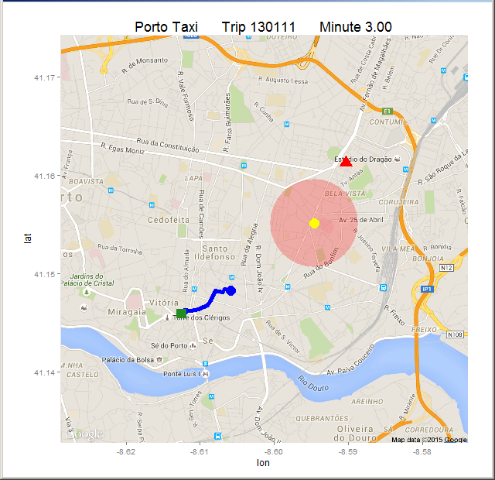
At 3 minutes.

Slide 18
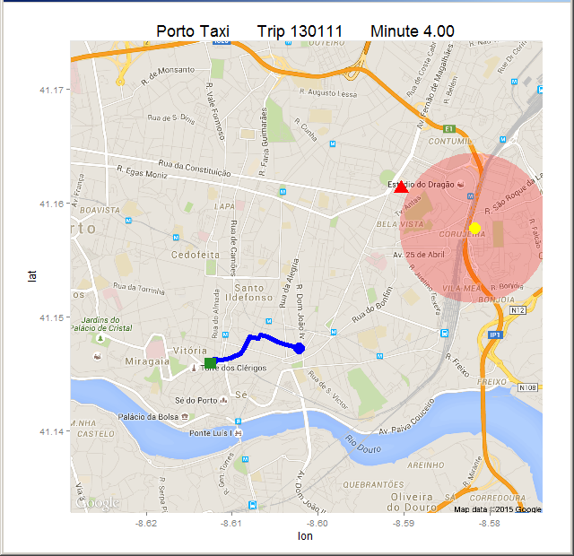
At 4 minutes:
Accuracy improving, despite taxi’s direction.

Slide 19
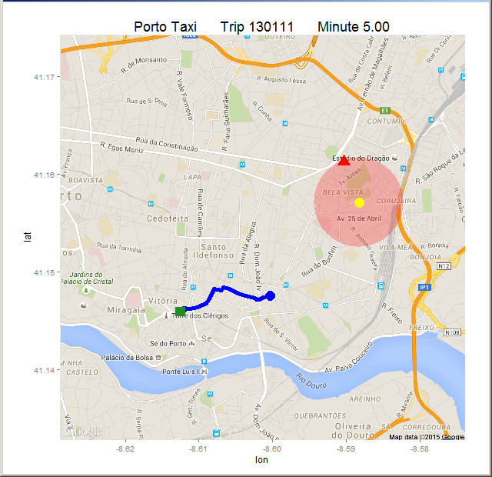
At 5 minutes.

Slide 20
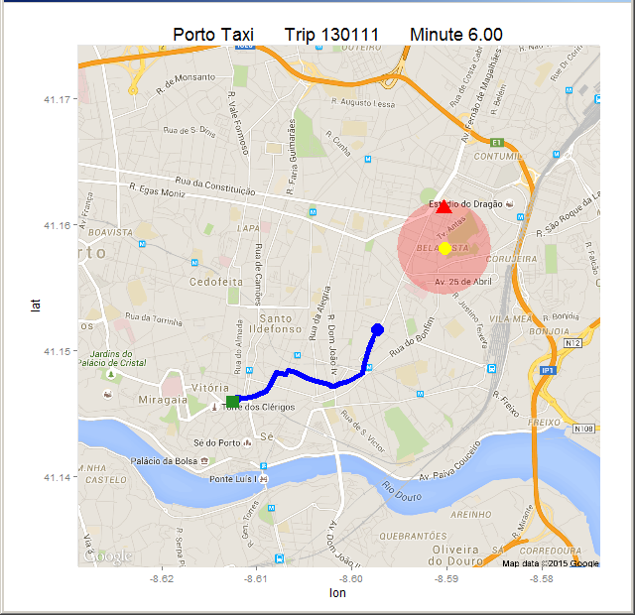
At 6 minutes:
The best prediction of the trip.

Slide 21
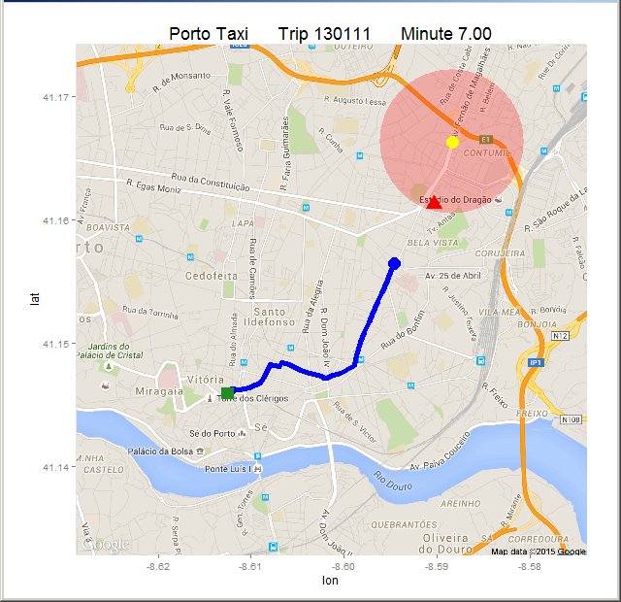
At 7 minutes.

Slide 22
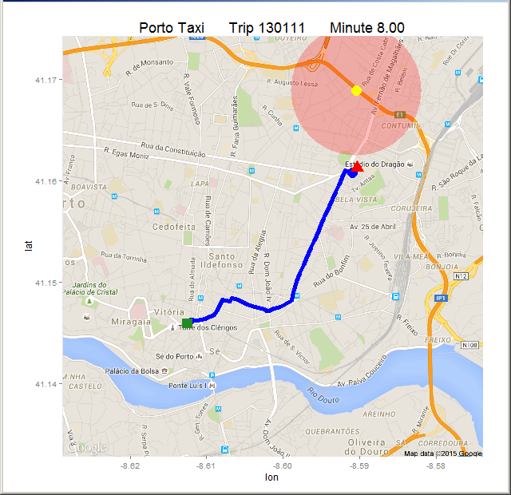
At 8 minutes:
Taxi leaves main road.

Slide 23
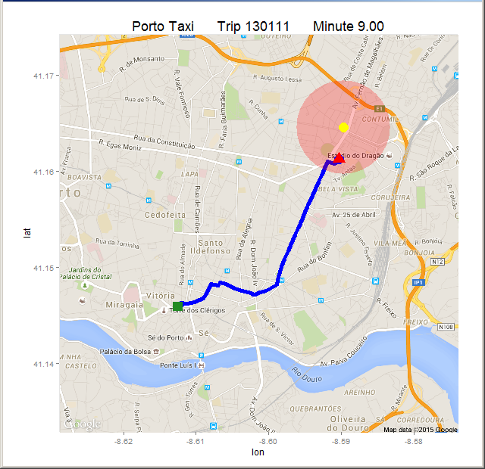
At 9 minutes.

Slide 24
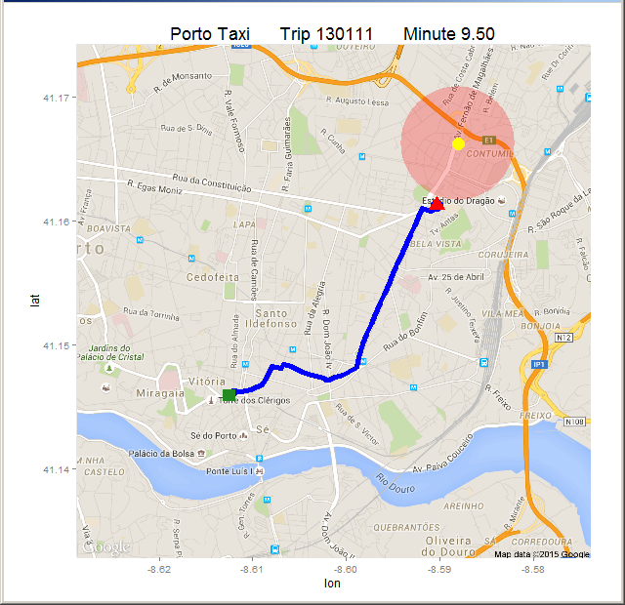
At the end.

Slide 25
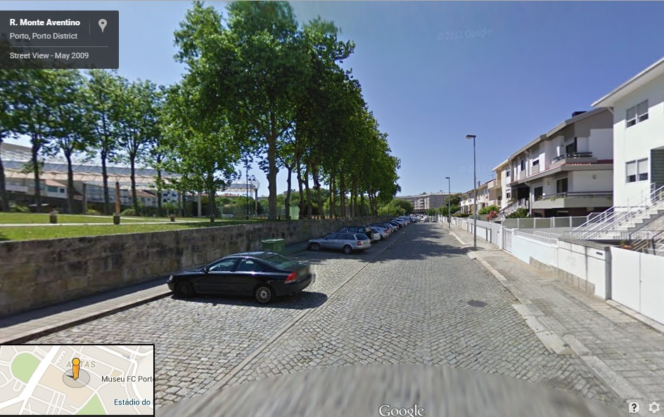
… and we are there.

Slide 26

Research Conclusion
Destinations of taxis on route can be predicted based on current and past trip data, but reliable accuracy is difficult.

Slide 27
Future Research
How can the model be improved?
Tune kNN for sparse data spaces
Leaving the main road may mean end of trip
Supplement kNN with a Markov model
kNN performs poorly for taxis in outlying areas
Research rules for special cases
Special events, customer preferences, etc.

Slide 28
Programming Notes
Data cleaning and preparation:
Python programs – 350 lines of code
Modelling with kNN:
R functions – 75 lines of code
Map plotting:
R functions – 60 lines of code
Using ggmap and ggplot2
Source code:
github.com/praynham/taxi-predict

